Slide 1
Nitrate’s Effect on Activity Tolerance in Heart Failure with Preserved Ejection Fraction (NEAT)
A Randomized Clinical Trial
Embargoed Until 3:45 p.m. ET, Sunday, Nov. 8, 2015
Margaret M Redfield
On behalf of the
NHLBI Heart Failure Clinical Research Network

Slide 2
Background
Exercise intolerance is a cardinal feature of HFpEF and perpetuates sedentary behavior, deconditioning and frailty.
Nitrates are commonly prescribed for symptom relief in HFpEF.

Slide 3
Background
The hemodynamic effects of nitrates may attenuate pulmonary congestion with exertion and improve exercise capacity in HFpEF.
HFpEF pts may be at increased risk for nitrate induced hypotension or other side effects.
  Ventricular and Vascular Stiffening
  Comorbid conditions
  Polypharmacy

Slide 4
Background
Patient-worn accelerometers provide continuous assessment of physical activity during daily life.
Daily activity may more accurately reflect the impact of a therapy on patient’s functional status.

Slide 5
Hypothesis
As compared to placebo, isosorbide mononitrate (ISMN) will improve daily activity in HFpEF patients as assessed by patient worn accelerometer devices.
  Average daily accelerometer units
Notes:
With these concepts in mind, the NEAT trial tested the hypothesis that
… and expressed as average daily accelerometer units

Slide 6
Study population
NYHA class II-IV HF symptoms + EF ≥ 50%
Objective evidence of HF (at least one)
      HF hospitalization
      Elevated NT-proBNP or BNP
      Elevated rest or exercise PAWP at RHC
      Echo Doppler Diastolic Dysf (≥ 2 variables)
Identify HF symptoms as the primary factor limiting ability to be active on screening questionnaire
    Versus neurologic, orthopedic or life-style factors
Notes:
Study population included patients with current class II-IV HF symptoms and normal EF who had objective evidence of HF as evidenced by either
Additionally, at study entry patients had to

Slide 7
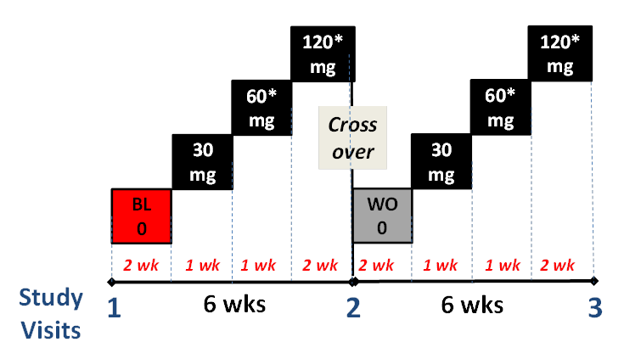
Study Design: Randomized, double-blind, placebo-controlled crossover study
* Or maximally tolerated dose
Notes:
NEAT was a…
At study visit 1 patients underwent baseline studies and received accelerometers
Patients took no study drug during the first two weeks to provide baseline accelerometer data
Patients were then up-titrated from 30 to 60 to 120 mg of study drug and continued on 120 mg or the maximally tolerated dose till Study visit 2 when baseline studies were repeated
Patients then were crossed over to the alternate treatment but took no study drug for 2 weeks to provide washout
Patients were again uptitrated as in phase 1 and then returned for the final endpoint assessment

Slide 8
NEAT Primary End-point
Average daily accelerometer units (AAU) during the 120 mg (or maximally tolerated) dose
  Two hip-worn, tri-axial, high sensitivity accelerometers
  Worn 24 hours per day (except bathing)
  Throughout the entire study
Notes:
The NEAT primary endpoint was
Patients wore an elastic belt with two high sensitivity

Slide 9
Secondary End-points
Additional accelerometer endpoints
  Hours active per day
  Activity during all doses of study drug (30, 60 and 120 mg).
Standard HF endpoints
  Six minute walk distance
  KCCQ
  NT-proBNP levels

Slide 10
Baseline Features
Characteristic | Placebo 1st (n=59) | ISMN 1st (N = 51)
Age (years) | 69 | 68
Female | 64% | 49%
White race | 92% | 86%
BMI (kg/m²) | 35 | 36
Hx hypertension | 92% | 88%
Hx of coronary disease | 61% | 63%
Diabetes | 36% | 43%
Hx of atrial fibrillation | 34% | 37%
Mean values or % shown
All p > 0.05
Notes:
Baseline characteristics by treatment sequence are shown here
Patients were elderly, 60% female, predominantly Caucasian and obese
25 % had been hsp for HF in the last year
Cardiovascular comorbidities were common and similar between groups

Slide 11
Baseline Features
Characteristic | Placebo 1st (n=59) | ISMN 1st (N = 51)
NYHA class II/III | 56% / 41% | 49% / 51%
6MWD (m) | 321 | 300
KCCQ (higher better) | 60 | 55
NT-proBNP (median, pg/ml) | 248 | 210
E/e’ - (normal ≤ 8) | 15 | 15
LAVI (ml/m²) - (normal < 29) | 39 | 41
Mean values or % shown except as noted
*p < 0.05
Notes:
Patient’s had controlled blood pressure
and NYHA class II or III HF symptoms consistent with their 6MWD and KCCQ scores
EF was over 60% and slightly higher in patients receiving placebo 1st
Median NTproBNP levels were approximately 250 pg/ml
Filling pressures were increased as evidenced by elevated values for E/e’ and LAVI
50% had evidence of concentric hypertrophy or remodeling

Slide 12
Agreement Between Accelerometers
Notes:
Accelerometers provided highly reproducible assessment of activity as evidenced by the tight correlation and agreement
between the two devices worn by each patient during each treatment period

Slide 13
Primary Endpoint
Notes:
The NEAT PEP is shown here.
During the 120 mg dose, as compared to placebo, patients tended to be less active with nitrate with a p value of 0.06

Slide 14
Primary and Secondary Endpoints
Notes:
Additional activity endpoints are shown here.
During the 120 mg dose, as compared to placebo, patients were active for fewer hours of the day with nitrate with a p value of 0.02
During all doses, as compared to placebo, patients were less active with nitrate with a p value of 0.02

Slide 15
Notes:
A dose response analysis is shown here.
As compared to baseline activity, there was a statistically significant and progressive decrease in activity with increasing doses of nitrate.

Slide 16
Notes:
In contrast, there was no significant dose effect of placebo on daily activity

Slide 17
Other Secondary Endpoints
 | Placebo N=110 | ISMN N=110 | P value
6 Minute Walk
Distance (m) | 321 | 322 | 0.91
KCCQ (Lower worse) | 61.6 | 59.7 | 0.16
NT-proBNP (pg/ml) | 497 | 550 | 0.22
Systolic BP (mmHg) | 129 | 125 | 0.04
Data are the model derived estimates of the mean treatment value
Notes:
Effects of nitrate on standard HF endpoints are shown here
There was no effect of nitrate on 6MWD or Borg Dyspnea score after the 6MW test
There were non-significant but unfavorable directional changes with nitrate in the KCCQ quality of life scores and NT-proBNP levels
There was a modest but significant decrease in blood pressure with isosorbide mononitrate

Slide 18
Safety / Tolerability Endpoints
Characteristic | Placebo N=110 | ISMN N=110
Discontinued study drug | 9 | 16
Any Event of Interest | 6 | 14
Arrhythmia | 2 | 2
Worsening HF | 1 | 5
Stroke | 0 | 1
Presyncope/Syncope | 3 | 6
All p > 0.05
Notes:
Safety and tolerability endpoints are shown here
As compared to placebo, with nitrate
Numerically more patients discontinued study drug and had events of interest including worsening heart failure and presyncope
There were no deaths
Three patients experienced non-cardiovascular SAEs during the trial

Slide 19
Summary
As compared to placebo, isosorbide mononitrate decreased daily activity levels and did not improve submaximal exercise capacity, quality-of-life scores or NT-proBNP levels in HFpEF patients.

Slide 20
Conclusions
These data do not support use of long acting nitrates for symptom relief in HFpEF.
Patient worn devices provide unique information about the impact of therapies on patients daily functional status
Notes:
These data …
Additionally, the NEAT findings suggest that

Slide 21
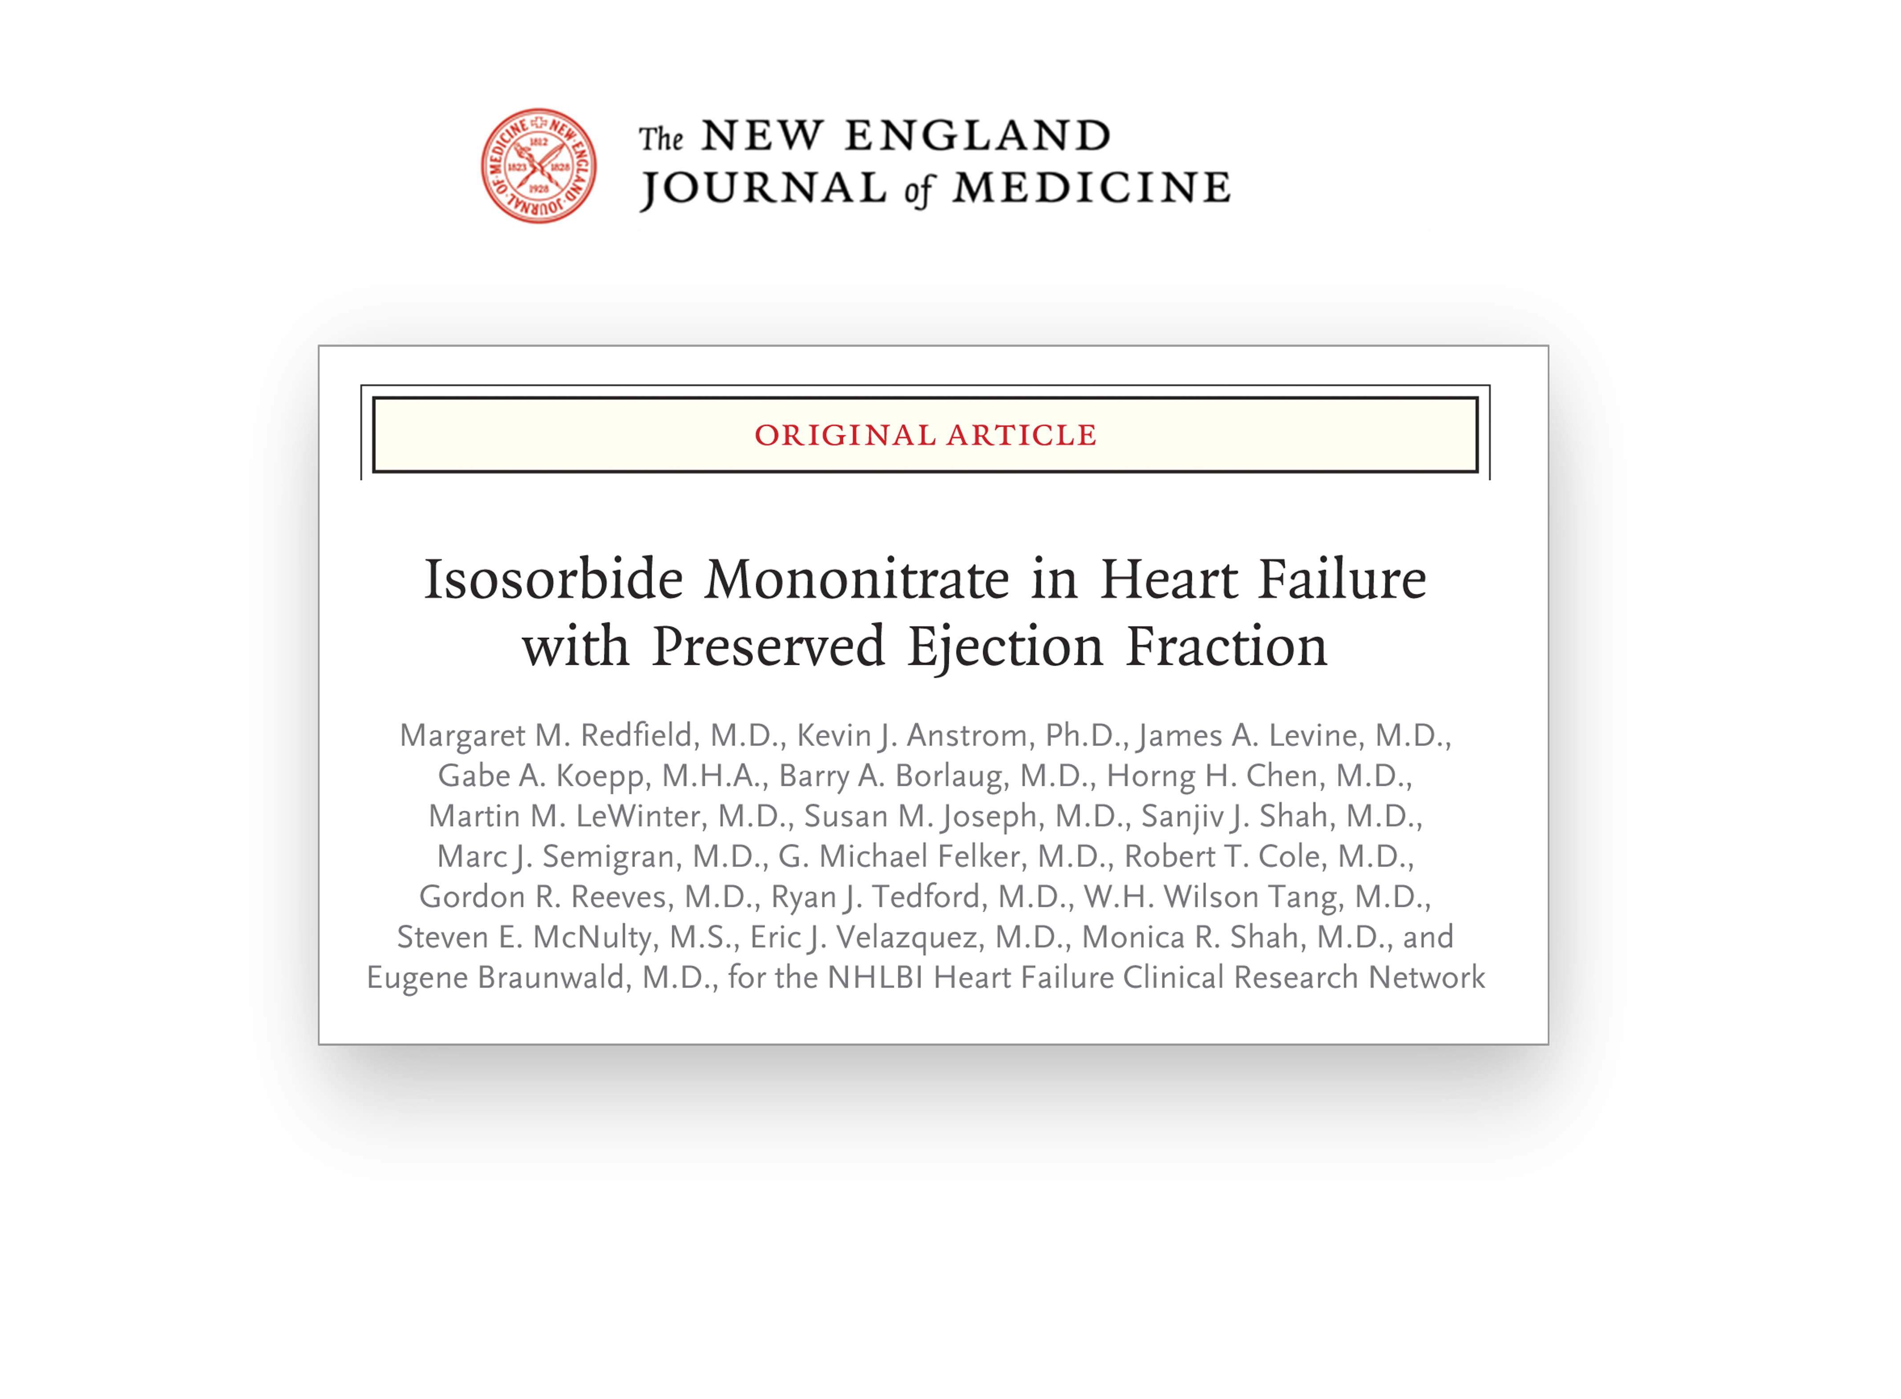
Notes:
The full study results are available on line today at NEJM.org

